Slide 1
IoT Based Water Level and Water Quality Monitoring System for Water Tanks
Project ID: CTP/2021/07 Supervised by Dr. Anuradha Jayakody
Perera H.A.K.D 20543912
Kasthuriarachchi S.D. 20543873

Slide 2
OVERVIEW
This proposed system is of an IoT based system to Manage and maintain water tanks in Domestic houses and small scale industries.
This system will provide a centralized system to manage and monitor status or water levels and water quality from any location at real time.
With the use of this system users can not only manage their Time efficiently but also overcome a number of technical issues related to management of water tanks.

Slide 3
INTRODUCTION
This proposed system to manage water quality and water levels of tanks.
This system can monitor the status of water levels in water tanks in real time and check the quality of water and display them in a centralized web application.
This system has several features such as,
Automatic alerting of users regarding water levels
Controlling or displaying status of the pumps
Checking status of the water in the tank.
This system will be built as two separate components, one component for measuring water levels and another to check for water quality.

Slide 4
PROBLEM IDENTIFICATION
People are unaware of the water levels of tanks and fill tanks until they overflow causing major water wastages.
Dry running of pumps due to low water levels present in tanks, high water pressure differences due to excess pumping of water can cause major problems.
Due to t he busy life styles of people they do not have tome to wait for tanks to be filled.
Detecting water contamination in tanks which store water is a problem when different water sources are used.

Slide 5
OBJECTIVES
Prevent wastage of water by at least 60%.
Provide a centralized system for users to view status of water levels, quality of water and pumping status of water to tanks.
Make pumping of water to tanks and view status of tanks easier.
Ensure that uncontaminated water is stored in tanks

Slide 6
RESEARCH QUESTIONS
ACCESSIBILITY
SYSTEM
TECHNOLOGIES
Is the proposed System accessible for domestic households and small-Scale industries.
What aspects of water quality measurement have the most importance and what could be included for this proposed system?
What fog computing systems and technologies could be used to automate a water quality and water level management system?

Slide 7
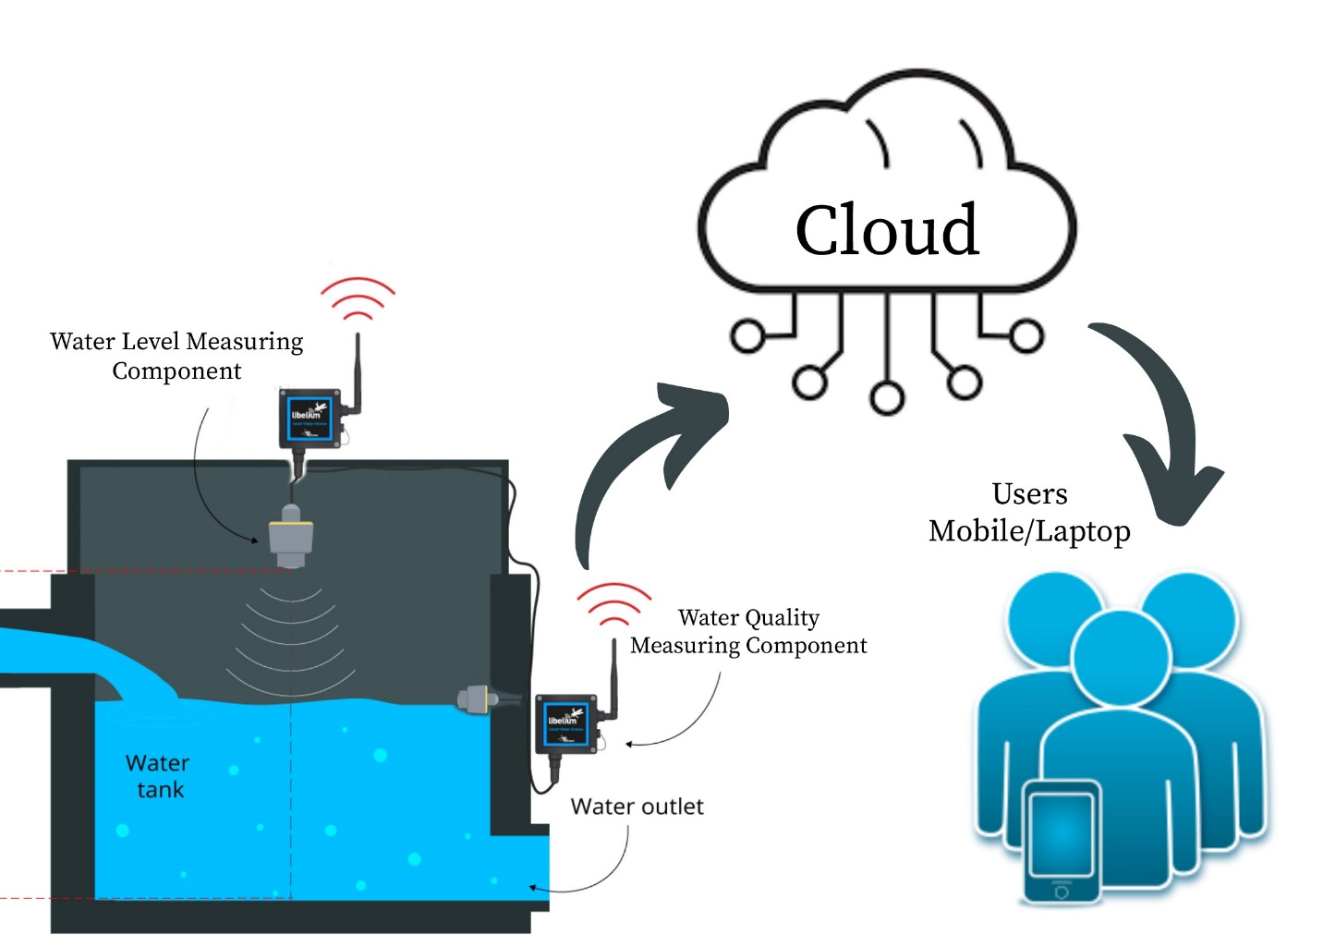
PROPOSED SOLUTION
Accessibility Diagram

Slide 8
REQUIREMENTS
Listed below are the requirements for users to successfully set up the system,
Each house or company must have a suitable water tank
Users must register to the system before using it.
Users must have a suitable device to access the web application.
Users must have suitable supply of water or electric power.
Listed below are the main requirements of the system,
The system must indicate proper water levels and water quality measurements at real time from any location.
The system must display pump status whether water is being pumped or not and provide alerting messages to users if water level is exceeding maximum capacity or is below required levels.
The pumps should be able to switch on or off using the system.

Slide 9
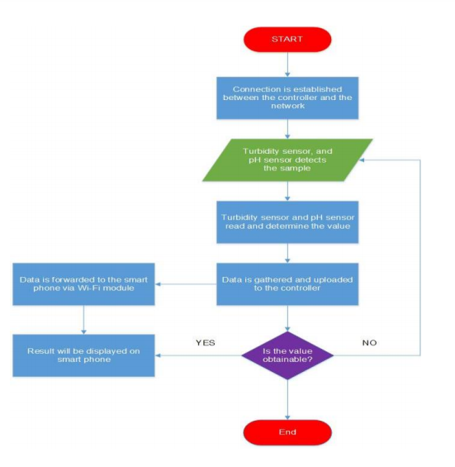

Slide 10
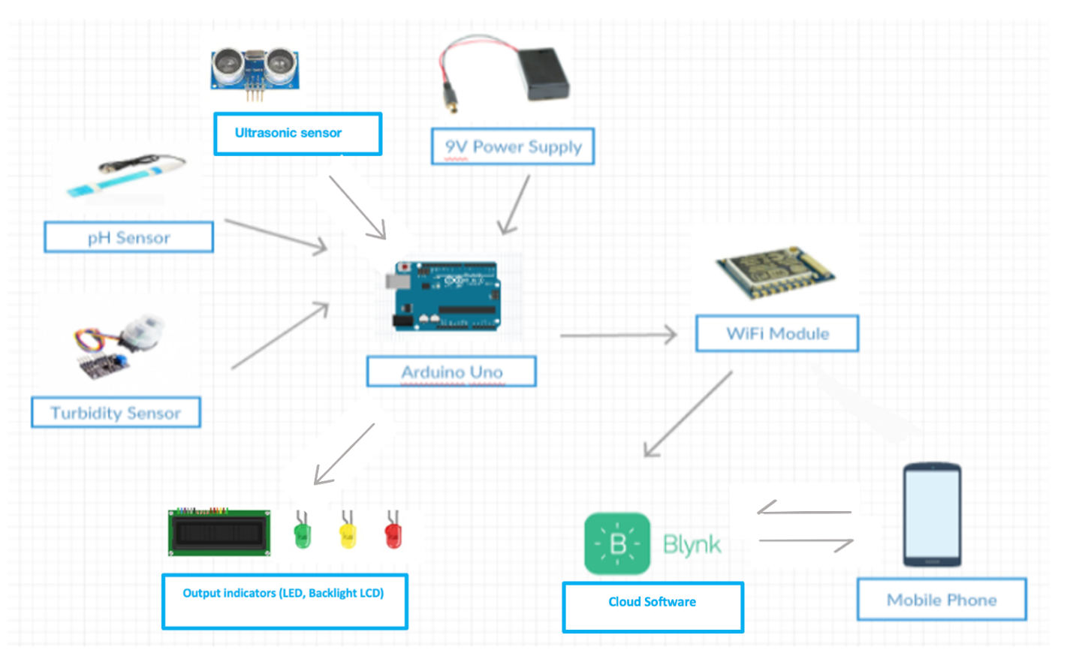
Water level and quality measurement system Accessibility diagram

Slide 11
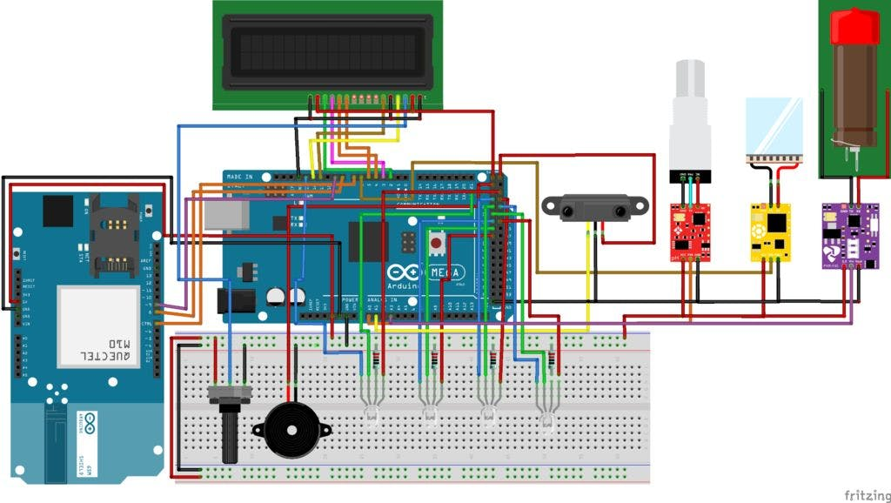
CURCUIT DIAGRAMS
Circuit Diagram of Water Quality Measuring Component

Slide 12
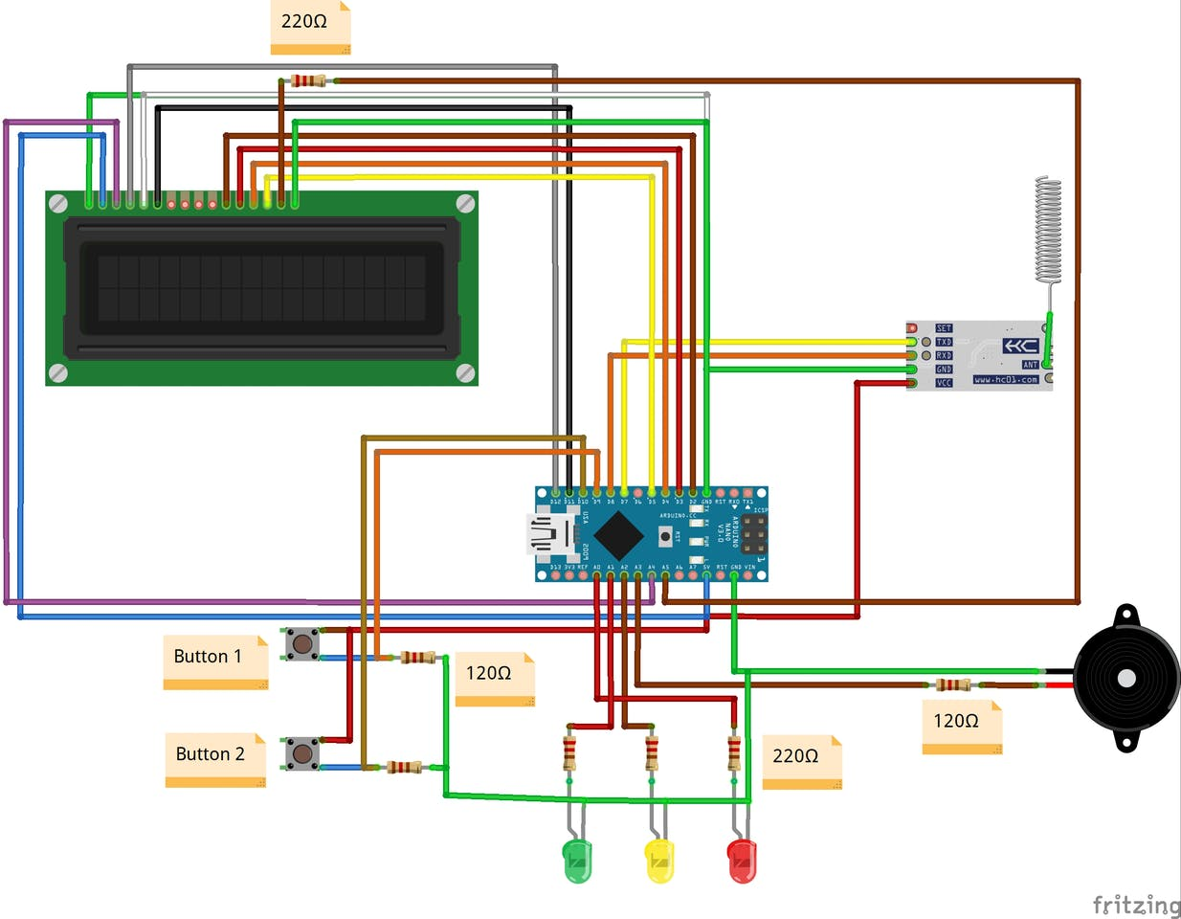
CURCUIT DIAGRAMS
Circuit Diagram of Water Level Measuring Component

Slide 13
GANTT Chart
Gantt Chart
Objectives | July |  |  |  | August |  |  |  | September |  |  |  | October
Gathering the required equipment and sensors
Developing the Web application
Develop the hardware model for the water level components
Develop the hardware model for the water quality components
Connecting the web app with the hardware components
Testing the devices

Slide 14
TESTING & EVALUATION
Testing
Evaluation
This project will be tested on 2 stages.
Stage 1- Testing of Indivigual Components & web app
Stage 2- Testing overall functionality of system
The system will be given to 5 domestic house owners or small-scale industry owners who have water tanks for 3 days and will evaluate the product on his personal ideas and thoughts and overall functionality of the system. This includes his satisfaction towards overall use of the system, helpfulness and functionality, ease of use and whether the requirements of the user have been met.

Slide 15
Thank You!
Any Questions?

